Slide 1
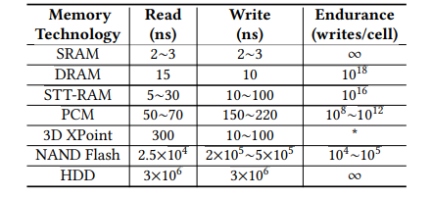
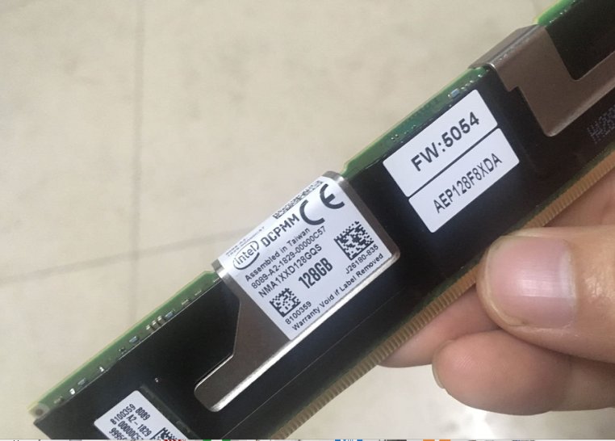
Various NVM technologies
The Intel Optane (3D Xpoint)
Notes:
My name is Li shengke. Come from China, is a student in Peking University. My work is a Performance Evaluation tool——NVMFS-Iozone. Time is short, I will pick some key points to talk about
In recent years, various NVM technologies are emerging and developing. The utilization of NVMs based on these technologies as the persistent media at memory level, is attracting more and more interest from both academia/ækəˈdiːmiə/ and industry. The most popular approach is to place NVM on the processor memory bus alongside conventional DRAM, which combines the best characteristics of both technologies. The 3D XPoint based NVMM such as the Intel Optane DC persistent memory is a common choice, because it is a mature technology and the performance is close to DRAM

Slide 2
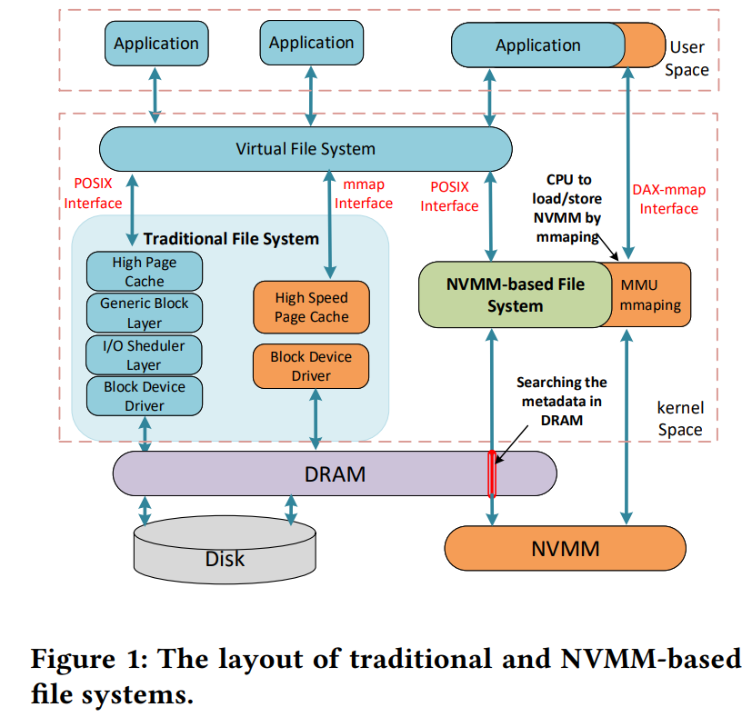
Two types of interfaces for file systems:
POSIX
mmap/DAX-mmap
Traditional file systems：
high speed page cache
data will be copied twice:
The new NVMM-based file systems:
bypassing the page cache and
bypassing the block-based I/O software stack.
Notes:
This Figure shows the layout of traditional and NVMM file systems. There are mainly two types of interfaces for file systems: POSIX and mmap/DAX-mmap. For both the traditional file systems, high speed page cache is used. And For the new NVMM-based file systems, it will bypass the page cache and the block-based I/O software stack/stæk/.
What’s more, With the mmap interface of NVMM file system, CPU can access the NVMM directly according to the mapping, which exposes/ik'spəuz/ the NVMM directly to the CPU, known as the DAX-mmap (shown in Figure 1). Most NVMM file systems in recent years support the DAX-mmap interface, and it is likely to be the dominant/dɒmɪnənt/ interface.

Slide 3
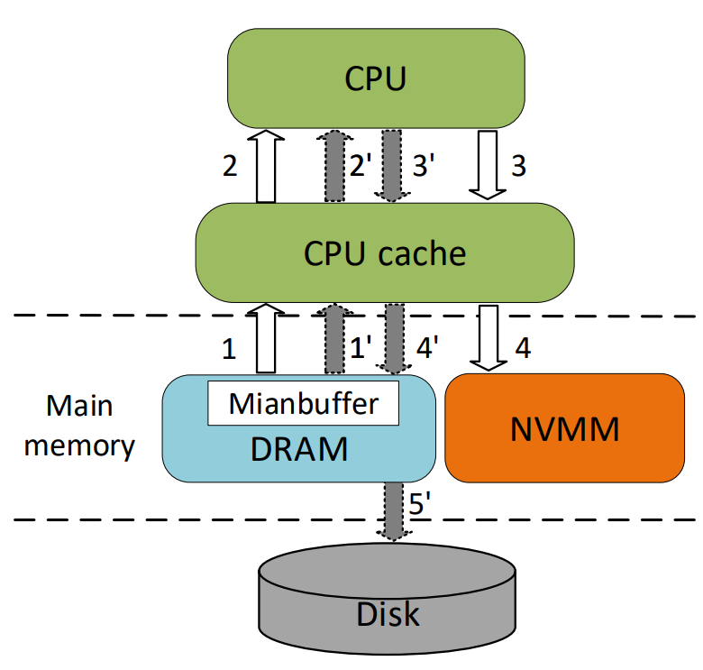
Allocating a Mainbuffer in DRAM using malloc()
Getting the VM address by mmap() to map the NVMM or disk space
Initializing Mainbuffer
Moving the Mainbuffer data from DRAM to Disk or NVMM by calling bcopy()
Executing msync() to keep the data consistent
Notes:
We know FIO and IOzone is popular benchmark tool. When we use FIO and IOzone benchmark the mmap interface, fritly, Allocating a Mainbuffer
1’→2’→3’→4’→5’is mmap of the traditional file systems and 1→2→3→4 is the DAX-mmap, This is Write, and the opposite is Read.

Slide 4
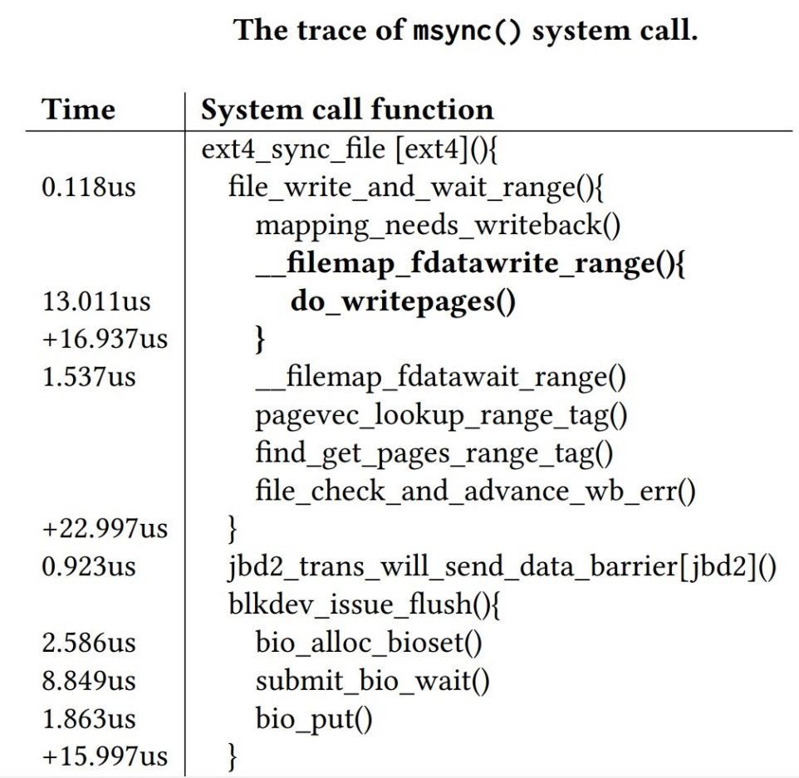
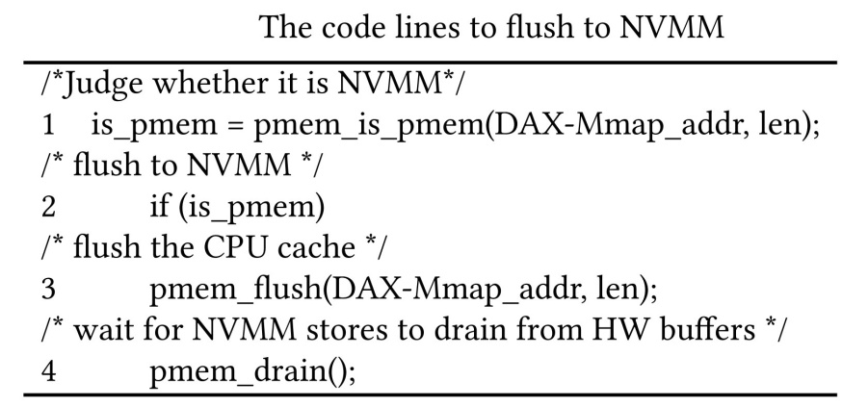
The flushing method
traditional evaluation tools call msync()
create a store barrier
require the operating system to find dirty pages
flush dirty pages to the disk
However， for the NVMM-based file system：
bypasses the page cache
CPU can load/store NVMM directly by the mapping
So, the operating system only needs to flush the CPU cache to write the changes to the NVMM
keep data consistent
Conveniently, Intel provides NVM libraries
libpmem
libpmemobj
Notes:
For both the traditional file system and the NVMM file system, existing evaluation tools usually call msync() to keep data consistent, which is a standard action for traditional file systems based on block devices/dɪˈvaɪs/. However, the msync() will create a store barrier, which requires the operation system to find dirty pages and flush them to the NVMM or disk. we use the kernel functional trace to track its subfunctions and the execution /ˌeksɪˈkjuːʃn/ time(shown in right Table). The left side of the table is the execution/ˌeksɪˈkjuːʃn/ time of the function and the right side is the corresponding function.. The function filemap_fdatawrite_range() is mainly to write back dirty pages in range. do_writepages will find dirty pages in the high speed page cache and then write them to the persistent memory. It takes a lot of time. However, these operations are meaningless/miːnɪŋləs/ for the DAX-mmap that bypasses the high speed page cache. Therefore, the operation system only needs to flush the CPU cache to write the changes to the NVMM.
Luckly, Intel provides NVM libraries. We mainly use two libraries in our benchmark tool. First we check whether it is NVMM . Then we flush the data in the CPU cache to NVMM by calling pmem_flush().

Slide 5
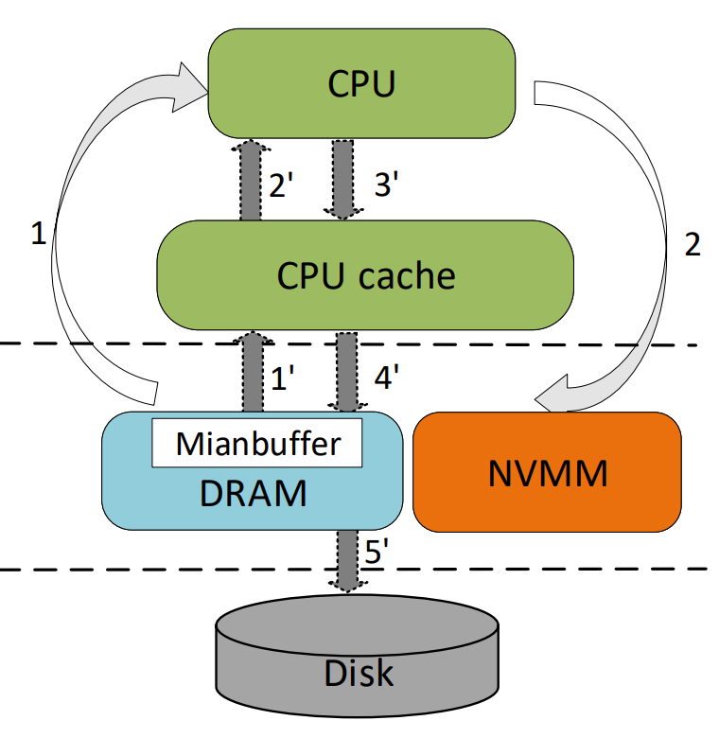
Bypassing the CPU cache
For scenarios where data is only used once , passing CPU cache will bring some overhead
when data in the files are only processed once, pursuing for even higher performance with the DAX-mmap interface,
Notes:
For tranditional tools, the data flow is DRAM to CPU cache to CPU to CPU cache to NVMM. Without disk I/O, the DAX-mmap can shorten the completion time of data flow and achieve low latency. for scenarios/sɪ'nɛrɪ,o/ where data is only used once, If it passes through the CPU cache, cache miss will be generated continuously/kən'tɪnjʊəsli/. Besides, the CPU cache also needs to be frequently flushed to keep data consistent. That overhead will not have a significant impact on traditional file systems where disk I/O is the main bottleneck/bɒt(ə)lnek/.
So in pursuing for even higher performance with the DAX-mmap, when data in the files are only processed once, serious considerations on bypassing the CPU cache will become a reasonable design choice. To support this potential need, we add the new data path of bypassing the CPU cache.

Slide 6
Experiment configuration
Optane DC persistent memory– NMA1XXD128GQS
Intel(R) Xeon(R) Platinum 8268 CPU @ 2.90GHz with cache size of 36608 KB
The DRAM is Micron with size of 128GB
Notes:
The following experiment/ik'speriment/ configuration---the NVM is Optane DC persistent memory, the size is 128GB. The CPU is intel with cache size of 36,608 KB. The DRAM is Micron 36ASF4G72PZ-2G3AZ. The SSD is Intel with 1.2TB.

Slide 7
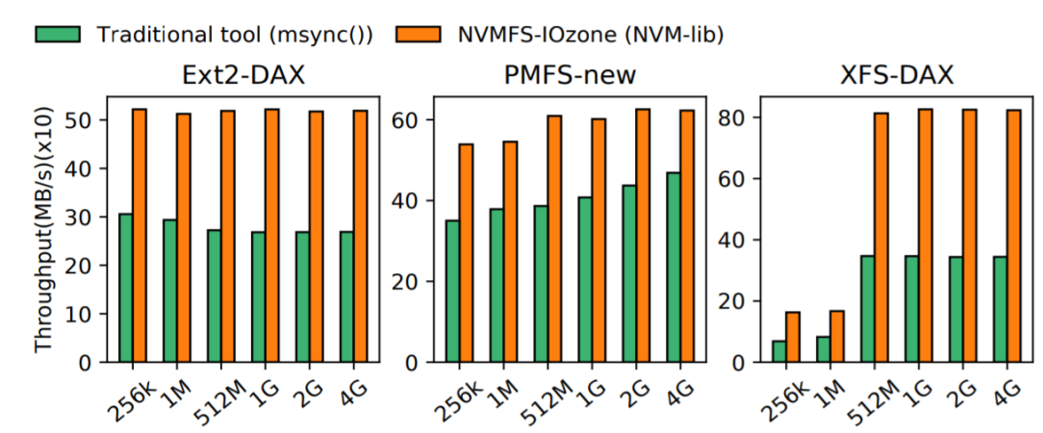
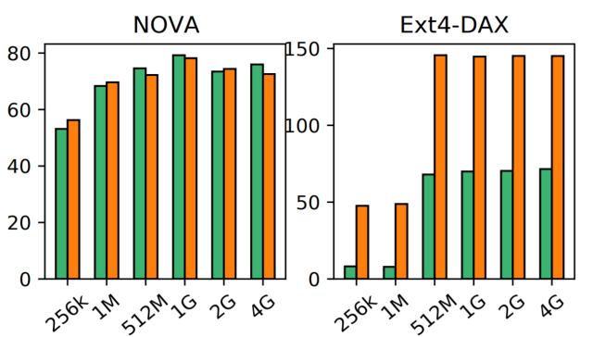
With an average increase of 1.4 times, and a maximum increase of 2.1 times
The overhead of the traditional msync() will largely under-evaluate the real performance of the NVMM-based file system
Notes:
we take IOzone to represent/reprɪ'zent/ traditional benchmark tools ,compare the msync() with the new NVM-lib. Except/ɪkˈsept/ nova, We can find that the throughput of NVM-lib are higher than that with the traditional msync(). These results confirm the effectiveness/ɪ'fektɪvnɪs/ of replacing the msync() with the NVM-lib method.
For NOVA, the two methods are very close. We can find out NOVA has changed the msync() behavior in its implementation, where it defines functions without those unnecessary actions. In conclusion, the overhead of the traditional msync() will largely under-evaluate the real performance of the NVMM- file system, and by switching to NVM-lib, new tool can reveal/rɪ'viːl/ the actual performance

Slide 8
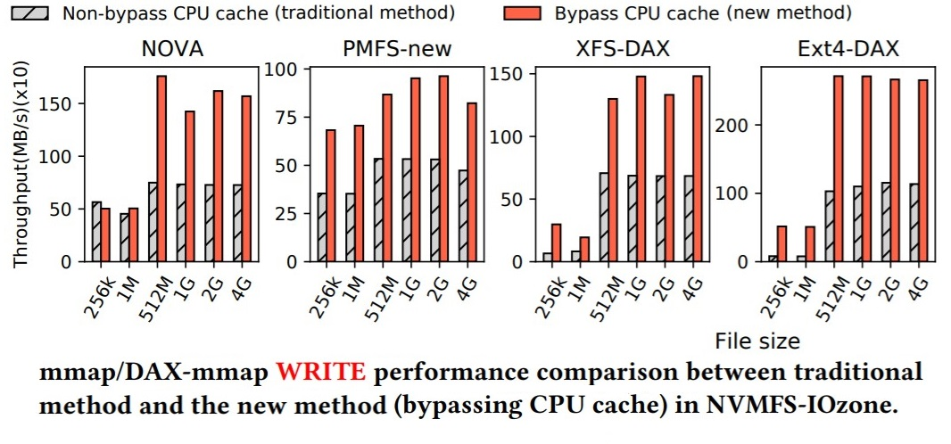
average 1.7 times higher
For the scenarios of data used once,
bypassing CPU cache is better
Notes:
Now, we try the new method of bypassing the CPU cache in comparison with the traditional method. The result in this Figure, for the data used once, the throughput of bypassing the CPU cache is higher than the traditional method, average/ævərɪdʒ/ 1.7 times higher Because the NVMM can be accessed directly and there is no overhead of disk I/O, so the overheads of cache miss and flushing CPU cache will cause significant impact on the throughput. Maybe bypassing CPU cache is meaningless for traditional file systems because the bottleneck is the disk I/O. However, for NVMM file systems, whether bypassing CPU cache or not has a big impact on performance, so it becomes a viable/vaɪəbl/ technique in pursuing for even higher performance. Making it an option in our new tool can be of big help to test those scenarios/si'na:riəu/, such as data used once.

Slide 9
NVMFS-Iozone
Using the NVM-lib from Intel instead of traditional msync() for data consistency, improving the accuracy of the evaluation results.
Supporting the direct data path between CPU and NVMM without the interference of the Mainbuffer in DRAM and other software stacks.
Adding the option of bypassing the CPU cache in the data path to support the evaluation of the new scenarios for NVMM-based file systems.
.
Notes:
In this paper, a new evaluation tool called NVMFS-IOzone is proposed to meet the new requirements of the NVMM file systems. Using the NVM-lib from Intel instead of traditional msync() for data consistent; Supporting the direct data path between CPU and NVMM; Adding the option of bypassing the CPU cache in the data path support the evaluation of the new scenarios for NVMM-based file systems.
. Their effectiveness/ɪ'fektɪvnɪs/ is verified with physical NVM hardware. The evaluation results show that our new benchmark tool can reveal the real performance not seen by traditional tools. That’s over. Thank you!

