Slide 1
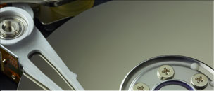

DARC: Design and Evaluation of an I/O Controller for Data Protection
M. Fountoulakis, M. Marazakis, M. Flouris, and A. Bilas
{mfundul,maraz,flouris,bilas}@ics.forth.gr
Institute of Computer Science (ICS)
Foundation for Research and Technology – Hellas (FORTH)
Notes:
Good afternoon. My name is Manolis Marazakis and I will present our work on building a storage controller with data protection features. This is joint work at FORTH-ICS, by Markos Fountoulakis, Michail Flouris, Angelos Bilas and myself.

Slide 2
Ever increasing demand for storage capacity
6X growth
2006: 161 Exabytes
2010: 988 Exabytes
¼ newly created, ¾ replicas
70% created by individuals
95% unstructured
[ source: IDC report on “The Expanding Digital Universe”, 2007 ]
Notes:
Based on IDC report, the growth of digital data from 2006 to 2010 is by a factor of 6. Furthermore, the report points out the existence of multiple copies per stored object (three quarters of total).

Slide 3
Motivation
With increased capacity comes increased probability for unrecoverable read errors
  URE probability ~ 10⁻¹⁵ for FC/SAS drives (10⁻¹⁴ for SATA)
  “Silent” errors, i.e. exposed only when data are consumed by applications – much later than write
  Dealing with silent data errors on storage devices becomes critical as more data are stored on-line, on low-cost disks
Accumulation of data copies (verbatim or minor edits)
  Increased probability for human errors
Device-level & controller-level defenses in enterprise storage
  Disks with EDC/ECC for stored data (520-byte sectors, background data-scrubbing)
  Storage controllers for continuous data protection (CDP)
What about mainstream systems?
  example: mid-scale direct-attached storage servers
Notes:
With increasing capacity, the rate of failures in storage devices increases as well. RAID technology masks device failures, assuming that the data is available in pristine condition. With the possibility of data corruption, other forms of data protection become necessary as well:
Versioning, to recover from user errors
Checksums, to protect against silent data corruption events
These additional data protection techniques need persistent state (”metadata”), to be maintained & accessed at high I/O rates along the common I/O path.

Slide 4
Our Approach: Data Protection in the Controller
(1) Use persistent checksums for error detection
  If error is recovered use second copy of mirror for recovery
(2) Use versioning for dealing with human errors
  After failure, revert to previous version
Perform both techniques transparently to
  (a) Devices: can use any type of (low-cost) devices
  (b) File-system and host OS (only a “thin” driver is needed)
Potential for high-rate I/O
  Make use of specialized data-path & hardware resources
  Perform (some) computations on data while they are on transit
Offloading work from Host CPUs, making use of specialized data-path in the controller
Notes:
In this work, we demonstrate by a prototype how data protection features can be implemented within a storage controller.
Not the only option … but still quite attractive.

Slide 5
Technical Challenges: Error Detection
Compute EDC, per data block, on the common I/O path
Maintain persistent EDC per data block
Minimize impact of EDC retrieval
Minimize impact of EDC calculation & comparison
Large amounts of state/control information needs to be computed, stored, and updated in-line with I/O processing

Slide 6
Technical Challenges: Versioning
Versioning of storage volumes
  timeline of volume snapshots
Which blocks belong to each version of a volume?
  Maintain persistent data structures that grow with the capacity of the original volumes
  Updated upon each write, accessed for each read as well
Need to sustain high I/O rates for versioned volumes, keeping a timeline of written blocks & purging blocks from discarded versions
… while verifying the integrity of the accessed data blocks

Slide 7
Outline
Motivation & Challenges
Controller Design
  Host-Controller Communication
  Buffer Management
  Context & Transfer Scheduling
  Storage Virtualization Services
Evaluation
Conclusions
Notes:
I will now proceed to discuss our controller design – specifically, four issues that in effect determine the performance potential of the controller:
- Host-controller communication
Buffer mgmt
Scheduling of processing & data transfers
Storage virtualization services

Slide 8
Host-Controller Communication
Options for transfer of commands
  PIO vs DMA
PIO: simple, but with high CPU overhead
DMA: high throughput, but completion detection is complicated
  Options: Polling, Interrupts
I/O commands [ transferred via Host-initiated PIO ]
  SCSI command descriptor block + DMA segments
  DMA segments reference host-side memory addresses
I/O completions [transferred via Controller-initiated DMA ]
  Status code + reference to originally issued I/O command
Notes:
PIO → simple (load/store instructions in specific memory regions), but incur CPU overhead. Not suitable for large data volumes.
DMA → high throughput (at PCIe rates), but complex to initiate and to detect their completion.
I/O command consists of SCSI CDB & DMA segments, with host-side addresses.
I/O completion consist of status-code & reference to corresponding commands.

Slide 9
Controller memory use
Use of memory in the controller:
  Pages to hold data to be read from storage devices
  Pages to hold data being written out by the Host
  I/O command descriptors & status information
Overhead of memory mgmt is critical for I/O path
  State-tracking “scratch-space” needed per I/O command
  Arbitrary sizes may appear in DMA segments
    Not matching block-level I/O size & alignment restrictions
  Dynamic arbitrary-size allocations using Linux APIs are expensive at high I/O rates
Notes:
So far, we had to touch on memory allocation concerns: for DMA transfer descriptors, and command/completion transfers.
What else is there?
Scratch-space per I/O command, arbitrary DMA segment sizes
Pre-allocated pool of fixed-size page-aligned chunks (4KB, 64KB)
Trade-off between space-efficiency & latency …

Slide 10
Buffer Management
Buffer pools
  Pre-allocated, fixed-size
    2 classes: 64KB for application data, 4KB for control information
    Trade-off between space-efficiency and latency
  O(1) allocation/de-allocation overhead
Lazy de-allocation
  De-allocate when:
    Idle, or under extreme memory pressure
Command & completion FIFO queues
  Host-Controller communication
  Statically allocated
  Fixed size elements

Slide 11
Context Scheduling
Identify I/O path stages
  Map stages to threads
  Don’t use FSMs: difficult to extend in complex designs
  Each stage serves several I/O requests at a time
Explicit thread scheduling
  Yield when waiting
    Overlap transfers with computation
  I/O commands and completions in-flight while device transfers are being initiated
  Avoid starvation/blocking of either side!
No processing in IRQ context
Default fair scheduler vs static FIFO scheduler
  Yield behavior

Slide 12
I/O Path – WRITE (no cache, CRC)
From Host
ISSUE
work-queue
submit_bio()
SAS/SCSI
controller
NEW-WRITE
work-queue
OLD-WRITE
work-queue
I/O Completion
(soft-IRQ handler)
[ CRC compute ]
IRQ
To Host
ADMA channel
Check for DMA
completion
[ CRC store ]
WRITE-COMPLETION
work-queue
Notes:
Incorporating checksums in the common I/O path.
- ADMA engine computes CRC32 value incrementally, as it transfers the data. So for writes, the NEW-WRITE context will initiate the DMA from-Host with the control bits set for CRC32 computation. The CRC32 value will be available upon DFMA completion, and will be stored in dedicated metadata space at the WRITE-COMPLETION stage.

Slide 13
I/O Path – READ (no cache, CRC)
From Host
To Host
ISSUE
work-queue
I/O Completion
(soft-IRQ handler)
[ CRC lookup & check ]
READ-COMPLETION
work-queue
OLD-READ
work-queue
NEW-READ
work-queue
[ CRC compute ]
Check for DMA
completion
submit_bio()
ADMA channel
IRQ
SAS/SCSI
controller
Notes:
For reads, the OLD-READ context initiates the DMA transfer to-Host with the control bits set for CRC32 computation. The CRC32 value will be available upon DMA completion, i.e. when the data has reached the Host. Before transmitting the I/O command completion, which will lead to the Host to “touch” the data and possibly suffer any data corruption, the controller will look-up the CRC32 value computed during the write that produced this data (per 4KB). In the event of a mismatch, the error recovery protocol is initiated … and in most cases this will hide the data-corruption from the Host (at the cost of increased latency in receiving the completion).

Slide 14
Storage Virtualization Services
DARC uses the Violin block-driver framework for volume virtualization & versioning
  M. Flouris and A. Bilas – Proc. MSST, 2005
Volume management: RAID-10
EDC checking (32-bit CRC32-C checksum per 4KB)
Versioning
  Timeline of snapshots of storage volumes
  Persistent data-structures, accessed & updated in-line with each I/O access:
    logical-to-physical block map
    live-block map
    block-version map

Slide 15
Storage Virtualization Layers in DARC Controller
Host-Controller Communication &
I/O Command Processing
Versioning
RAID-0
RAID-1
RAID-1
EDC
EDC
EDC
EDC
/dev/sda
/dev/sdb
/dev/sdc
/dev/sdd

Slide 16
Block-level metadata issues
Performance
  Every read & write request requires metadata lookup
  Metadata I/Os are small-sized, random, and synchronous
  Can we just store the metadata in memory ?
Memory footprint
  For translation tables: 64-bit address per 4KB block → 2 GBytes per TByte of disk-space
    Too large to fit in memory!
  Solution: metadata cache
Persistence
  Metadata are critical: losing metadata results in data loss!
  Writes induce metadata updates to be written to disk
  Only safe way to be persistent is synchronous writes → too slow!
  Solutions: journaling, versioning, use of NVRAM, …

Slide 17
What about controller on-board caching ?
Typically, I/O controllers have an on-board data cache:
  Exploit temporal locality (recently-accessed data blocks)
  Read-ahead for spatial locality (prefetch adjacent data blocks)
  Coalescing small writes (e.g. partial-stripe updates with RAID-5/6)
Many intertwined design decisions needed …
  RAID levels affect cache implementation:
  Performance
  Failures (degraded RAID operation)
DARC has a simple block-cache, but it is not enabled in the evaluation experiments reported in this paper.
  All available memory is used for buffers to hold in-progress I/O commands, their associated data _and_ metadata for the data protection functionality.
Notes:
Typically, I/O controllers have an on-board cache. We have done some work in our prototype to incorporate a cache, and we will discuss the design issues involved.
Cache on the controller serves 3 purposes:
-temporal locality exploitation (if any)
-spatial locality exploitation, via read-ahead
-coalescing of small writes
Cache design intertwined with RAID implementation (distinction bet. Normal and Degraded-Mode operation)

Slide 18
Outline
Motivation & Challenges
Controller Design
  Host-Controller Communication
  Buffer Management
  Context & Transfer Scheduling
  Storage Virtualization Services
Evaluation
  IOP348 embedded platform
  Micro-measurements & Synthetic I/O patterns
  Application Benchmarks
Conclusions
Notes:
I will now describe the experimental system, and present evaluation results.

Slide 19
Experimental Platform
Intel 81348-based development kit
  2 XScale CPU cores - DRAM: 1GB
  Linux 2.6.24 + Intel patches (isc81xx driver)
8 SAS HDDs
  Seagate Cheetah 15.5k (15k RPM, 72GB)
Host: MS Windows 2003 Server (32-bit)
  Tyan S5397, DRAM: 4 GB
Comparison with ARC-1680 SAS controller
  Same hardware platform as our dev. kit
Notes:
-The prototype is developed using an IOP348 development kit.
-I will a comparison with a commercially available controller based on the same hardware platform.

Slide 20
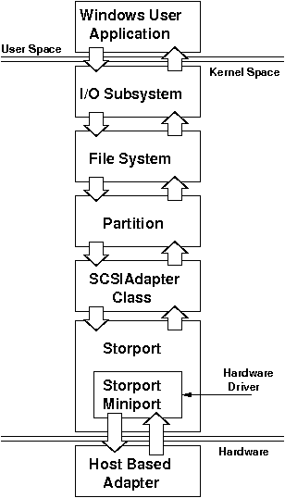
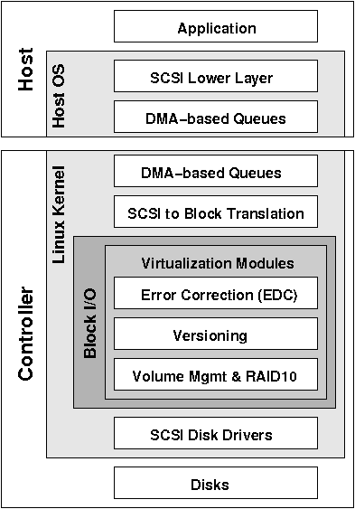
I/O Stack in DARC - “DAta pRotection Controller”
Notes:
In our prototype, the Host is a Windows SCSI Host-Based Adapter Driver, while the Controller runs Linux-based firmware.

Slide 21
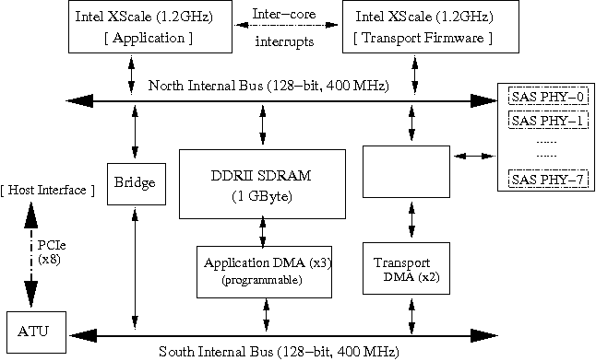
Intel IOP348 Data Path
SRAM
(128 KB)
DMA engines
Special-purpose
data-path
Messaging Unit
Notes:
The data-path of IOP348:
Address translation & messaging unit, for host-controller interaction
- 3 programmable DMA engines, plus two separate DMA engines for transport of data to SAS devices
- 2 “wide & fast” data buses

Slide 22
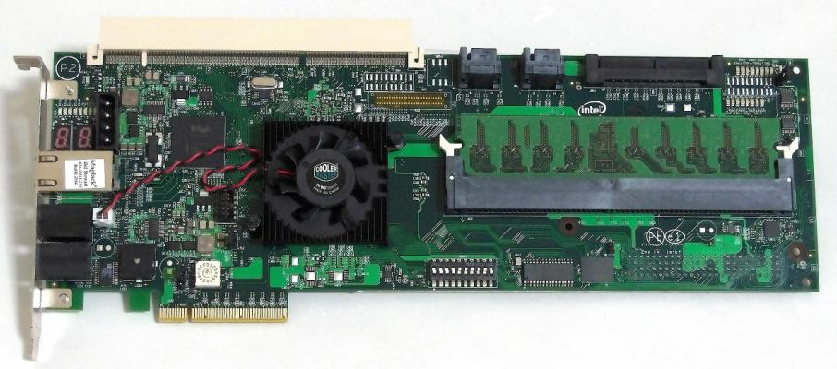
Intel IOP348
[ Linux 2.6.24 kernel (32-bit) + Intel IOP patches (isc81xx driver) ]
Notes:
22
The Intel IOP348, available in development-kit form:
-This is what we have used for our prototype.
-Linux-based firmware.

Slide 23
“Raw” DMA Throughput
Notes:
Raw DMA throughput of Controller
PCI-Express, 8 lanes (2.5 Gbit/sec each) → theoretical limit: 2 GB/sec (to/from Host)
Measured: 1.6 GB/sec, to-Host vs 1.4 GB/sec (from-Host)

Slide 24
Streaming I/O Throughput
RAID-0, IOmeter RS pattern
[ 8 SAS HDDs ]
Throughput collapse!
Notes:
Memory allocation matters at high I/O rates → Throughput collapse with the default Linux allocator, at queue-depths >16.
Worth noticing that if the Host can generate large DMA segments, the I/O throughput improves even at low queue depths.
DARC has no read-ahead capability, unlike ARC-1680.

Slide 25
IOmeter results: RAID-10, OLTP pattern
Notes:
IOPS performance for DARC, with the OLTP (4KB) i/o pattern.
ARC-1680 only achieves ~ 67% of the IOPS performance of DARC.

Slide 26
IOmeter results: RAID-10, FS pattern

Slide 27
TPC-H (RAID-10, 10-query sequence)
+12%
+2.5%
Notes:
Figure shows impact of EDC+versioning on execution time for 10 queries of the TPC-H benchmark.
Since TPC-H issues very few writes, the impact of versioning is very small (+2.5%, on top of 12% for EDC).

Slide 28
JetStress (RAID-10, 1000 mboxes, 1.0 IOPS per mbox)
Notes:
Small, synchronous writes on Log volume → write-buffer helps to absorb them, and hide their latency from the application.
If we disable write-cache on ARC-1680, this effect becomes evident.
Even without write-cache, DARC (marginally) achieves the “1000 IOPS” performance goal with EDC checks enabled. With versioning enabled, DARC misses the target IOPS score (~ 950 IOPS) … but still this is better than the performance of ARC-1680 in write-through mode (~930). With write-back caching, ARC-1680 achieves ~1478 IOPS.

Slide 29
Conclusions
Incorporation of data protection features in a commodity I/O controller
  integrity protection using persistent checksums
  versioning of storage volumes
Several challenges in implementing an efficient I/O path between the host machine & the controller
Based on a prototype implementation, using real hardware:
  Overhead of EDC checking: 12 - 20%
    Depending on # concurrent I/Os
  Overhead of versioning: 2.5 - 5%
    With periodic (frequent) capture & purge
    Depending on number and size of writes
Notes:
In summary, we have designed and implemented two data protection features within a controller:
-persistent checksums for integrity protection
-versioning of storage volumes, to protect against human errors.
From our experiments, on real hardware, we have found the overhead of EDC checking to be in the range of 12 to 20%, depending on the number of concurrent I/Os. Versioning adds a further overhead, in the range of 2.5 to 5%, depending on the number & size of writes.

Slide 30
Lessons learned from prototyping effort
CPU overhead at controller is an important limitation
  At high I/O rates
  We expect CPU to issue/manage more operations on data in the future
  Offload on every opportunity
Essential to be aware of data-path intricacies
  To achieve high I/O rates
  Overlap transfers efficiently
    To/from host
    To/from storage devices
Emerging need for handling persistent metadata
  Along the common I/O path, with increasing complexity
  Increased consumption of storage controller resources
Notes:
To conclude, here is a listing of the lessons derived from our prototyping effort:
CPU overhead at the controller is an important limitation, much more than the capabilities of the system interconnect that provides host connectivity
We expect CPU overhead to become critical as we expect more operations on data in the common I/O path
We always need to consider ways to offload, or even eliminate, work from the controller CPU.
It is essential to be aware of data-path intricacies, especially to overlap transfers:
To/from host … as well as to/from storage devices.
We see an emerging need for handling persistent metadata in the common I/O path, as a response to more demanding data protection requirements.

Slide 31

Thank you for your attention!
Questions?
“DARC: Design and Evaluation of an I/O Controller for Data Protection”
Manolis Marazakis, maraz@ics.forth.gr
http://www.ics.forth.gr/carv
Notes:
Thank you for your attention, I’d be glad to answer any questions.

Slide 32
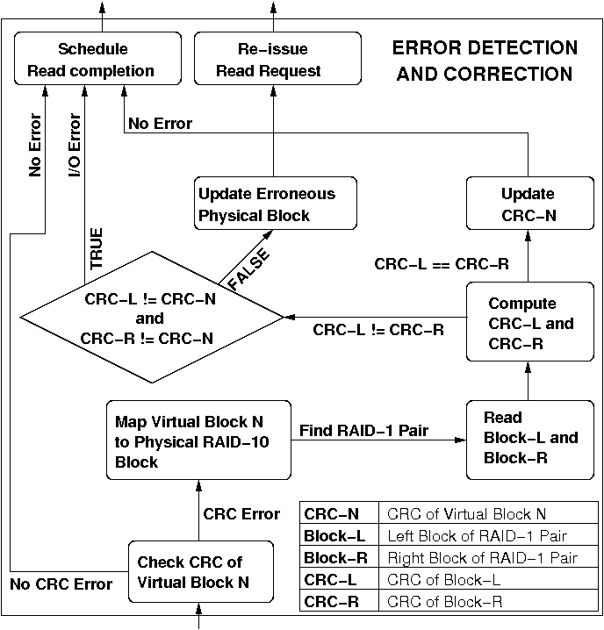
Silent Error Recovery using RAID-1 and CRCs
Notes:
If the stored checksum does not match the computed, we proceed to check the mirror copies. This requires the capability to map the “virtual” block# to physical block locations, on the devices that make up the RAID-10 volume. After this map is made available, the mirror copies of the referenced block are retrieved and their corresponding checksums are computed. These checksums are then compared to one another. If they match, we update the stored checksum and proceed to complete the read request. Otherwise, if one of them matches the stored checksum, we proceed to re-issue the original read request, after synchronizing the mirror copies.

Slide 33
Recovery Protocol Costs
Case | Data I/Os | CRC I/Os | CRC calc’s | Outcome
RAID-1 pair data differ, CRC matches one block | 3 | 0 | 2 | Data recovery, re-issue I/O
RAID-1 pair data identical, CRC does not match | 2 | 1 | 2 | CRC recovery
RAID-1 pair data differ, CRC does not match | 2 | 0 | 2 | Data error, Alert Host

Slide 34
Selection of Memory Regions
Non-cacheable, no write-combining for
  controller’s hardware-resources (control registers)
  controller outbound PIO to host memory
Non-cacheable + write-combining for
  DMA descriptors
  Completion FIFO
  Intel SCSI driver command allocations
Cacheable + write-combining
  CRCs: allocated along with other data to be processed
    explicit cache management
  Command FIFO
    explicit cache management
Notes:
Memory management on the controller is getting even more complex: Intel Xscale is a non-coherent architecture!
Two properties to be set per memory region: cacheable? Write-combining enabled?
Specific choices in our prototype …

Slide 37
Prototype Design Summary
Challenge | Design Decision
Host-Controller I/F | PIO for commands/completions, DMA for data
Buffer management | Pre-allocated buffer pools, lazy de-allocation, fixed-size ring buffers (command/completion FIFOs)
Context scheduling | Map stages to work-queues (threads), explicit scheduling, no processing in IRQ-context
On-board Cache | [ Optional ] for data-blocks, “closest” to host
Data Protection | Violin framework within the Linux kernel: RAID-10 volumes, versioning (based on re-map), persistent metadata - including EDC CRC32-C checksums, computed per-4KB by DMA engine during transfers, persistently stored (within dedicated metadata space)
Notes:
A summary of the prototype design, as presented so far …

Slide 38
Impact of PIO on DMA Throughput
8KB DMA transfers
Notes:
Controller does DMA transfers to/from Host, while Host issues commands PIO.
Impact of “interfering PIO” on DMA throughput is significant!
To-Host: 1.6 GB/sec → < 0.5% degradation, From-Host: 1.3 GB/sec → 0.8 GB/sec, Two-way: 2 GB/sec → 1 GB/sec

Slide 39
IOP348 Micro-benchmarks
IOP348 clock cycle | 0.833 nsec (1.2 GHz)
Interrupt delay, CTX SW | 837 nsec | 1004.8 cycles
Memory store | 99 nsec | 118.8 cycles
Local-bus store | 30 nsec | 36 cycles
Outbound store (PIO write, to host) | 114 nsec | 136.8 cycles
Outbound load (PIO read, from host) | 674 nsec | 809.1 cycles
Outbound load with DMA transfers | 3390 ns | 4069.6 cycles
Outbound load with DMA transfers and inbound PIO-Writes from host | 5970 ns | 7166.8 cycles
Host clock cycle: 0.5 nsec (2.0 GHz)
Host –initiated PIO write: 100 nsec (200 cycles)
Notes:
On IP348, interrupts & context-switch are quite fast.
PIO-Read from-Host is expensive !
A PIO-Write to-Host costs 140 cycles … whereas a PIO-Read from-Host costs over 800 cycles.
Concurrently with DMA to-Host, PIO-Read costs more than 4000 cycles, or even 6000 cycles with contending PIO-Writes from the Host.

Slide 40
Impact of Linux Scheduling Policy
[ with PIO completions ]
Notes:
Thread scheduling matters at high I/O rates → With FIFO scheduler, we reach the limit of 8 SAS drives (1 GB/sec).
With fair-share scheduler, we achieve 20% less throughput.

Slide 41
I/O Workloads
IOmeter patterns:
  RS, WS
    64KB sequential read/write stream
  OLTP (4KB)
    random 4KB I/O (33% writes)
  FS
    file-server (random, misc. sizes, 20% writes)
      80% 4KB, 2% 8KB, 4% 16KB, 4% 32KB, 10% 64KB
  WEB
    web-server (random, misc. sizes, 100% reads)
      68% 4KB, 15% 8KB, 2% 16KB, 6% 32KB, 7% 64KB, 1% 128KB, 1% 512KB
Database workload:
  TPC-H
    (4GB dataset, 10 queries)
Mail server workload:
  JetStress (1000 100MB mailboxes, 1.0 IOPS/mbox)
    25% insert, 10% delete, 50% replace, 15% read
41

Slide 42
Co-operating Contexts (simplified)
ISSUE
SCSI command pickup,
SCSI control commands
SCSI completions
Pre-allocated Buffer Pools
+ Lazy Deallocation
Data for Writes
DMA from host
Data for Reads
DMA to host
BIO
block-level I/O issue
END_IO
SCSI completion to Host
Notes:
Here is a somewhat simplified view of the I/O processing within the controller.
5 stages (details will follow later, specifically for reads & writes):
ISSUE → interactions with Host (pickup of SCSI commands, forwarding of completions)
BIO → issue I/O requests to Linux block-layer
END_IO → after block-layer completion, take steps to send SCSI completion and data to Host
DATA (separate for reads & writes) → DMA to/from Host, wait for DMA transfer completion

Slide 43
Application DMA Channel (ADMA)
Device interface: chain of transfer descriptors
Transfer descriptor := (SRC, DST, byte-count, control-bits)
  SRC, DST: physical addresses, at host or controller
Chain of descriptors is held in controller memory
… and may be expanded at run-time
Completion detection:
  ADMA channels report (1) running/idle state, and (2) address of the descriptor for the currently-executing (or last) transfer
  Ring-buffer of transfer descriptor IDs: (Transfer Descriptor Address, Epoch)
  Reserve/release out-of-order, as DMA transfers complete
DMA_Descriptor_ID post_DMA_transfer(Host Address,
Controller Address, Direction of Transfer, Size of Transfer, CRC32C Address)
Boolean is_DMA_transfer_finished(DMA Descriptor Identifier)
Notes:
DMA is offered by specialized hardware engines. A specific case-study is the ADMA units in IOP348.
The hardware unit’s interface is as follows:
-Chain of transfer descriptors, i.e. (DST,SRC,LENGTH,CTRL-FLAGS) tuples
-kept in controller memory – can be dynamically expanded. Hint that this is crucial for performance!
How do we detect DMA transfer completion? ADMA reports idle/running, and the address of the currently-executing transfer descriptor.
So, we need to correlate transfer-descriptors with transfer addresses. Transfers may complete out-of-order.
Ring-buffer of pre-allocated transfer descriptors → again, a memory allocation concern is addressed statically, by design.
API: post_DMA_transfer() → returns descriptor-ID (position in ring-buffer), is_DMA_transfer_finished() returns true/false

Slide 44
Command FIFO: Using DMA
New-head
: valid queue element
head
: element to enqueue
: valid element to dequeue
Host
tail
PCIe interconnect
DMA
head
tail
Controller
Controller initiates DMA
Needs to know tail at Host
-Host needs to know head at Controller
New-tail
Notes:
Let’s see how commands are handled – using DMA, and using PIO. Completions are similar.
To facilitate interactions, we organize commands in fixed-length ring FIFO. Host enqueues commands for the Controller to pick-up & service. Commands are represented as FIFO elements (fixed-size). This design also has an important memory-allocation aspect: FIFOs are statically allocated, and can be used in constant-time without dynamic memory allocation.
Controller needs to initiate DMA between head-tail positions from the host to its own “mirror copy” of the FIFO.
Host & Controller need not keep their (head, tail) values in perfect synchrony.
Host needs to know controller’s head value, so as to determine if it is safe to reclaim FIFO elements on its side.
Host cannot simply “push” commands: Controller has to be the DMA initiator. Controller has to check from time to time if new commands are available → Host or Controller may “starve” !

Slide 45
Command FIFO: Using PIO
: valid queue element
head
tail
: element already enqueued
Host
pointer
updates
PIO
PCIe interconnect
head
tail
head
tail
Controller
Host executes PIO-Writes
Needs to know head at Controller
-Controller needs to know tail at Host
New-tail
Notes:
With host-initiated PIO, the operation of the Command FIFO becomes simpler.
Host & Controller still synchronize (head,tail) … but again, no tight synchrony is necessary.
Host needs to know head at Controller, to avoid overwrite of pending commands if it fills-up the ring FIFO.
Controller should not read values from Host (too expensive – see this later on, in micro-measurements).
Rather, each side writes its own values (PIO-Write).
Controller needs to know tail at host → important optimization: Controller can find tail on its own … if Host marks-up valid commands.

Slide 46
Completion FIFO
PIO is expensive for controller CPU
We use DMA for Completion FIFO queue
Completion transfers can be piggy-backed on data transfers
  For reads

Slide 47
Command & Completion FIFO Implementation
IOP348 ATU-MU provides circular queues
  4 byte elements
  Up to 128KB
  Significant management overheads
Instead, we implemented FIFOs entirely in software
  Memory-mapped across PCIe
    For DMA and PIO direct access

Slide 48
Context Scheduling
Multiple in-flight I/O commands at any one time
  I/O command processing actually proceeds in discrete stages, with several events/notifications being triggered at each
Option-I: Event-driven
  Design (and tune) dedicated FSM
  Many events during I/O processing
    Eg: DMA transfer start/completion, disk I/O start/completion, …
Option-II: Thread-based
  Encapsulate I/O processing stages in threads, schedule threads
We have used Thread-based, using full Linux OS
  Programmable, infrastructure in-place to build advanced functionality more easily
  … but more s/w layers, with less control over timing of events/interactions
Notes:
I/O commands are services in stages, with several events in each stage (e.g: DMA start/completion, disk i/o start/completion)
Option #1 is to design an event-driven FSM. Option #2 is to design a thread-based system, where each threads incorporates handling several of the many events.
In our prototype, we took Option #2, using full Linux OS. This gives us a programmable infrastructure to build advanced storage features more easily (in line with our goals in the prototype). However, with more software layers we have less control over timing of events and interactions.

Slide 49
Scheduling Policy
Threads (work-queues) instead of FSMs
  Simpler to develop/re-factor code & debug
  Can block independently from one another
Default Linux scheduler (SCHED_OTHER) is not optimal
  Threads need to be explicitly pre-empted when polling on a resource
  Events are grouped within threads
Custom scheduling, based on SCHED_FIFO policy
  Static priorities, no time-slicing (run-until-complete/yield)
    All threads at same priority level (strict FIFO), no dynamic thread creation
    Thread order precisely follows the I/O path
      Crucial to understand the exact sequence of events
  With explicit yield() when polling, or when "enough" work has been done - always yield() when a resource is unavailable
Notes:
So we need to schedule threads … but what is the best scheduler to use?
We found that the default fair-share scheduler is not the best choice → often our threads would spend time essentially idling until pre-emption, in circumstances where it was definite that they could no longer make forward progress.
We used the FIFO scheduling class of Linux, where threads run to completion or until they explicitly yield.
We sketched-out a thread execution order that closely matches the actual sequence of events in the I/O path. Threads yield when a resource or a desired event is not yet available.

Slide 50
Controller On-Board Cache
Typically, I/O controllers have an on-board cache:
  Exploit temporal locality (recently-accessed data blocks)
  Read-ahead for spatial locality (prefetch adjacent data blocks)
  Coalescing small writes (e.g. partial-stripe updates with RAID-5/6)
Many design decisions needed
RAID affects cache implementation
  Performance
  Failures (degraded RAID operation)
Notes:
Typically, I/O controllers have an on-board cache. We have done some work in our prototype to incorporate a cache, and we will discuss the design issues involved.
Cache on the controller serves 3 purposes:
-temporal locality exploitation (if any)
-spatial locality epxloitation, via read-ahead
-coalescing of small writes
Cache design intertwined with RAID implementation (distinction bet. Normal and Degraded-Mode operation)

Slide 51
On-board Cache Design Decisions
Placement of the cache
  Near the host interface, near the storage devices
Mapping function & associativity
  Replacement policy
Handling of writes
  Write-back, write-through
  Write-allocate, write no-allocate
Handling of partial hits/misses
Concurrency / Contention
  Many in-flight requests
  Dependencies between pending accesses
    Hit-under-miss, mapping conflicts
    Contention for individual blocks
      E.g: Read/Write for a block currently being written-back
Cache access involves several steps
(DMA and I/O issue/completion)
Notes:
Here is the list of design issues …
Performance+Reliability is the key driver.
Partial hits?
Hit-under-miss?
Contention cases for individual blocks? Cache access involves several steps (accesses via both Host-side DMA & device I/O)

Slide 52
A specific cache implementation
Block-level cache (4KB blocks)
Placed “near” the host interface
  The cache is accessed right after the ISSUE context
Direct-mapped, write-back + write-allocate
Supports partial hits/misses (for multi-block I/Os)
  Locking at the granularity of individual blocks
    Avoid “stall” upon block misses
Notes:
Here are the specific design decisions in our prototype → just enough to expose the performance issues, not “thorough” enough for the reliability concerns

Slide 53
I/O Stack in DARC - “DAta pRotection Controller”
User-Level Applications
System Calls
Virtual File System (VFS)
Raw I/O
File System
Buffer Cache
Block-level Device Drivers
SCSI Layer
Storage Controller
Notes:
Overview of our controller prototype, which is built using real hardware:
- SCSI-layer at Host & its co-ordination with the controller’s firmware.
- The controller’s firmware contains several layers, as described earlier.

Slide 54
MS Windows Host S/W Stack
ScsiPort: half-duplex
StorPort: full-duplex
Direct manipulation of SCSI CDBs

Slide 55
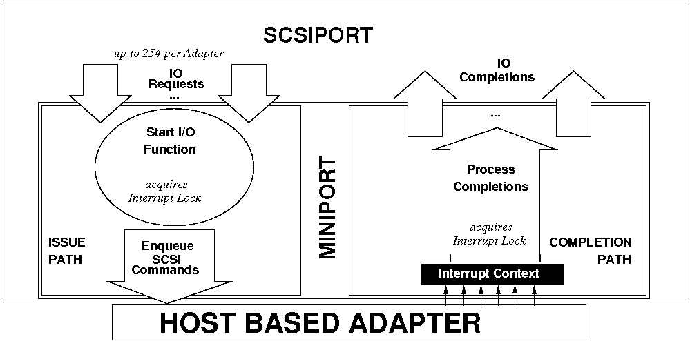
Half-Duplex: ScsiPort

Slide 56
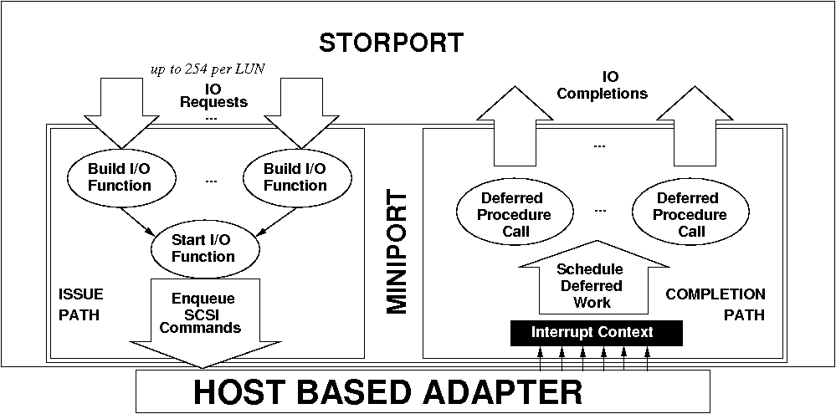
Full-duplex: StorPort

