Slide 1
BioSEAL:
In-Memory Biological Sequence Alignment Accelerator for Large-Scale Genomic Data
Roman Kaplan, Leonid Yavits and Ran Ginosar
Department of Electrical Engineering
Technion

Slide 2
Part 1: Background and Previous Work
Motivation
Background:
  Content Addressable Memory (CAM)
  Associative Processing
  Memristors
Previous work: Resistive CAM (ReCAM)

Slide 3
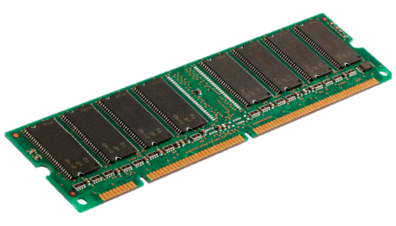
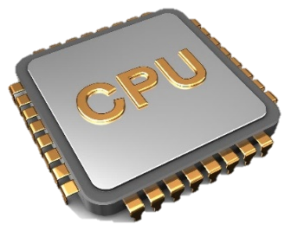


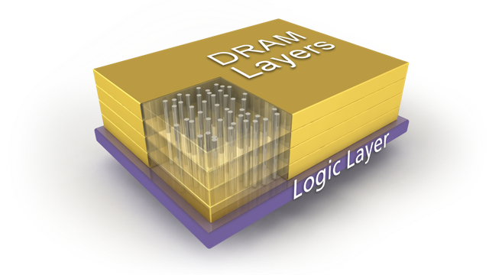
Motivation: Overcome the von Neumann Bottleneck
Traditional processing: Mem ↔ CPU / GPU
Major bottleneck for big data workloads
Even worse in a datacenter
11000101…
Micron’s Hybrid Memory Cube

Slide 4

Background: Content Addressable Memory
Large array of bitcells (usually #Rows $≫$ #Columns)
Search in parallel for a specific pattern
Columns
Bit
Bit
Rows

Slide 5
Content Addressable Memory (CAM)
Compare
Compare Pattern
(1X01…0)
1
0
X
X
0
1
1
0
0
1
Matching
Rows

Slide 6
Content Addressable Memory (CAM)
Write
Write Pattern
(0X10X…X)
0
1
1
0
0
1
CAM Bitcell
CAM Bitcell
CAM Bitcell
Matching
Rows
CAM Bitcell
CAM Bitcell
CAM Bitcell

Slide 7
Associative Processing
Also called “Lookup table” computing
Uses compare-write combinations
  Goes over the entire truth-table
Trades time for (much) less logic
  E.g., half-adder requires 4 compare-write combinations (8 cycles)
A | B | C_{out} | S
0 | 0 | 0 | 0
0 | 1 | 0 | 1
1 | 0 | 0 | 1
1 | 1 | 1 | 0

Slide 8
Toy Example: Associative Vector Addition
A₀+B₀ →C_{out} , S
Memory map
Half Adder Truth table
A
B
C_{out}
S
A | B | C_{out} | S
0 | 0 | 0 | 0
0 | 1 | 0 | 1
1 | 0 | 0 | 1
1 | 1 | 1 | 0
2 |  | 0 | 2 |  | 0 | 2 |  | 0
0 | 1 | 0 | 1 | 1 | 0
1 | 0 | 1 | 0 | 1 | 0
1 | 1 | 0 | 1 | 0 | 1
0 | 0 | 1 | 1 | 1 | 1
1 | 1 | 0 | 0 | 1 | 0
0 | 1 | 0 | 1 | 0 | 1
1 | 0 | 1 | 1 | 1 | 0
1 | 1 | 1 | 0 | 0 | 1

Slide 9


Example: Associative Vector Addition
Compare
Write
Memory map
Half Adder Truth table
A
B
C_{out}
S
A | B | C_{out} | S
0 | 0 | 0 | 0
0 | 1 | 0 | 1
1 | 0 | 0 | 1
1 | 1 | 1 | 0
2 |  | 0 | 2 |  | 0 | 3 |  |  | 0
0 | 1 | 0 | 1 | 1 | 0
1 | 0 | 1 | 0 | 1 | 0
1 | 1 | 0 | 1 | 0 | 1
0 | 0 | 1 | 1 | 1 | 1
1 | 1 | 0 | 0 | 1 | 0
0 | 1 | 0 | 1 | 0 | 1
1 | 0 | 1 | 1 | 1 | 0
1 | 1 | 1 | 0 | 0 | 1
Evaluation
0
0
0
1
0
1
1
0
0
0
0
1
0
1
1
0

Slide 10
Example: Associative Vector Addition
Compare
Write
Memory map
Full Adder Truth table
A
B
C_{out}
S
0
0
0
1
0
0
0
1
A | B | C_{in} | C_{out} | S
0 | 0 | 0 | 0 | 0
0 | 0 | 1 | 0 | 1
0 | 1 | 0 | 0 | 1
0 | 1 | 1 | 1 | 0
1 | 0 | 0 | 0 | 0
1 | 0 | 1 | 0 | 1
1 | 1 | 0 | 0 | 1
1 | 1 | 1 | 1 | 0
1 | 0
0 | 1
0 | 1
1 | 0
1 | 0
0 | 1
0 | 1
1 | 0
2 |  | 0 | 2 |  | 0 | 3 |  |  | 0
0 | 1 | 0 | 1 | 1 | 0 |  |  |  | 0
1 | 0 | 1 | 0 | 1 | 0 |  |  |  | 1
1 | 1 | 0 | 1 | 0 | 1 |  |  |  | 1
0 | 0 | 1 | 1 | 1 | 1 |  |  |  | 0
1 | 1 | 0 | 0 | 1 | 0 |  |  |  | 0
0 | 1 | 0 | 1 | 0 | 1 |  |  |  | 1
1 | 0 | 1 | 1 | 1 | 0 |  |  |  | 1
1 | 1 | 1 | 0 | 0 | 1 |  |  |  | 0

Slide 11
Associative Processing – Main Takeaway
Processing in a fixed number of cycles, regardless of dataset size
A
B
S
2 |  | 0 | 2 |  | 0 | 3 |  |  | 0
0 | 1 | 0 | 1 | 1 | 0 | 0 | 1 | 0 | 0
1 | 0 | 1 | 0 | 1 | 0 | 0 | 0 | 1 | 1
1 | 1 | 0 | 1 | 0 | 1 | 1 | 0 | 1 | 1
0 | 0 | 1 | 1 | 1 | 1 | 1 | 0 | 0 | 0
1 | 1 | 0 | 0 | 1 | 0 | 1 | 1 | 0 | 0
0 | 1 | 0 | 1 | 0 | 1 | 0 | 0 | 1 | 1
1 | 0 | 1 | 1 | 1 | 0 | 1 | 0 | 1 | 1
1 | 1 | 1 | 0 | 0 | 1 | 1 | 1 | 0 | 1
Vector length
does not matter

Slide 12
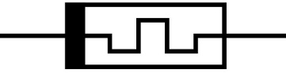
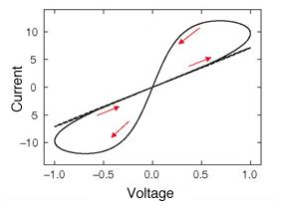
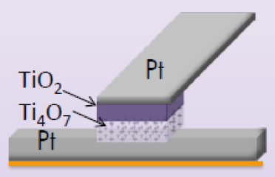
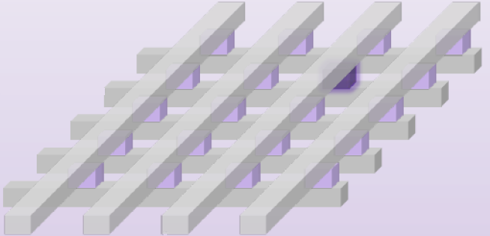
So What’s New? Memristors
Devices that change resistance with applied voltage
Non volatile
Can be placed in metal layers
above silicon
Small area footprint: 4F²

Slide 13
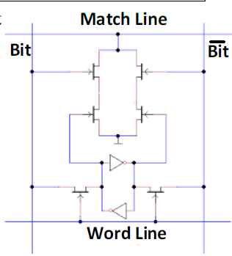
Resistive CAM Bitcell
CAM bitcell: 10 transistors ➔ 2 transistors + 2 memristors
CMOS CAM bitcell (10T)
Resistive CAM bitcell (2T2R)
Kaplan, R., Yavits, L., Ginosar, R. and Weiser. “A Resistive CAM Processing-in-Storage Architecture
for DNA Sequence Alignment.” IEEE Micro, 37(4), pp.20-28, 2017.

Slide 14
ReCAM Crossbar – Single Chip
CAM registers
Logic next to data
Data row: 256bit
TAG
Rows
(16M)
1-bit TAG connection (shift down)
2T2R Bitcell
(ReRAM)
Kaplan, R., Yavits, L., Ginosar, R. and Weiser. “A Resistive CAM Processing-in-Storage Architecture for DNA Sequence Alignment.” IEEE Micro, 37(4), pp.20-28, 2017.

Slide 15

Compare in ReCAM
All rows are precharged
Mismatching rows cause a discharge through low-resistance memristor
1
0
0
1
0
1
1
0
Kaplan, R., Yavits, L., Ginosar, R. and Weiser. “A Resistive CAM Processing-in-Storage Architecture for DNA Sequence Alignment.” IEEE Micro, 37(4), pp.20-28, 2017.

Slide 16
ReCAM Operations
Two instruction types:
  In-row (e.g., A+B→C)
  Shift-down by one row
Multiplication is implemented as a combination of ‘+’
Cycles per operation:
32 bit
Instruction | Cycles
B ← A + B | 256
C ← A + B | 512
Row-wise Max (A, B) | 64
Max Scalar (A) | 128
Shift down by one row | 128

Slide 17
Part 2: Our Contribution, BioSEAL
ReCAM drawbacks & our solutions
New ReCAM: Batch Write ReCAM (BW-ReCAM)
BioSEAL Array
Performance and energy efficiency comparsions to other architectures

Slide 18
ReCAM Drawback #1
In each data row, most compare operations mismatch
  Every truth table entry matches only one row
Solution: NAND, instead of NOR
NAND CAM Bitcell
Match: discharge
Mismatch: no discharge
Precharge

Slide 19
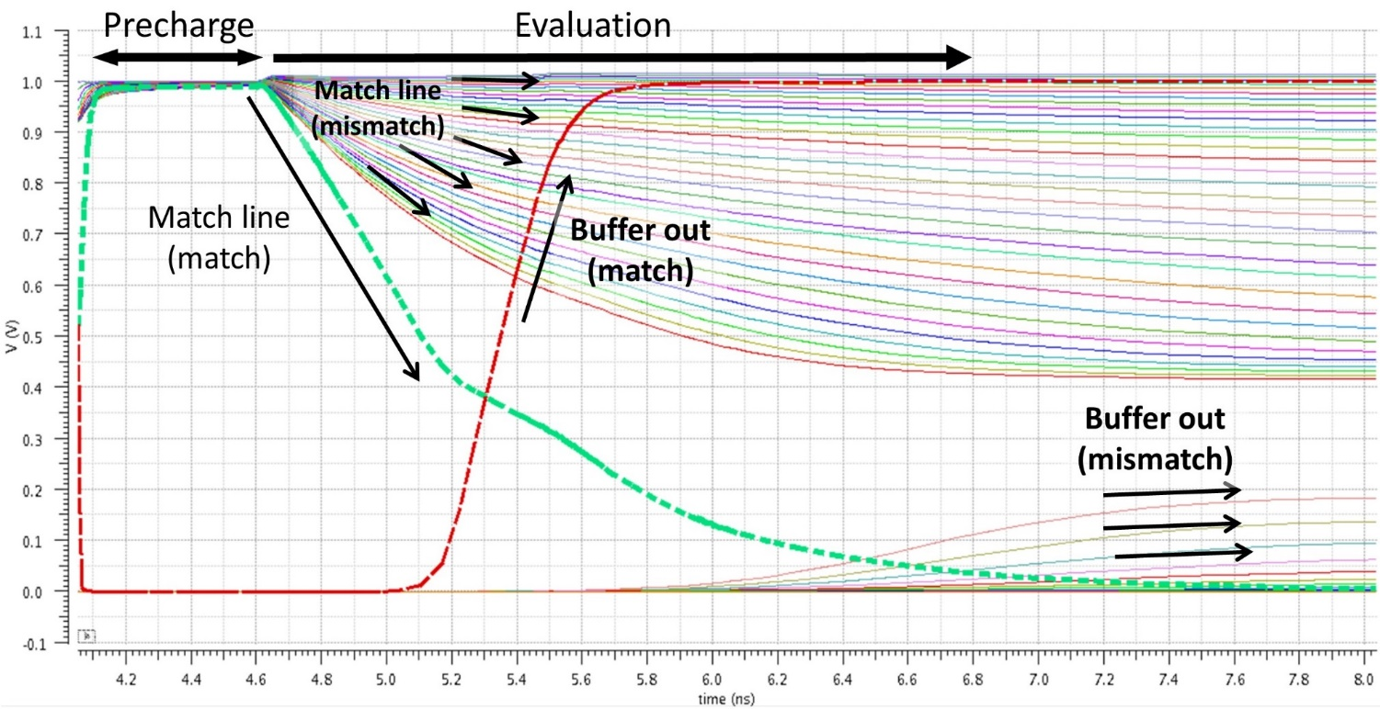
NAND ReCAM
Circuit simulation (32 bitcells)
1
2
1
2

Slide 20
ReCAM Drawback #2
The same output value is written in separate cycles
Solution
Improved TAG logic: Batch-writes to one cycle
16 cycles
(One write cycle per entry)
12 cycles
(One write cycle per output value)
Input |  |  | Output
A | B | C_{in} | S | C_{out}
0 | 0 | 0 | 0 | 0
0 | 0 | 1 | 0 | 1
0 | 1 | 0 | 0 | 1
0 | 1 | 1 | 1 | 0
1 | 0 | 0 | 0 | 1
1 | 0 | 1 | 1 | 0
1 | 1 | 0 | 1 | 0
1 | 1 | 1 | 1 | 1
Input |  |  | Output
A | B | C_{in} | S | C_{out}
0 | 0 | 0 | 0 | 0
0 | 0 | 1 | 0 | 1
0 | 1 | 0 | 0 | 1
1 | 0 | 0 | 0 | 1
0 | 1 | 1 | 1 | 0
1 | 0 | 1 | 1 | 0
1 | 1 | 0 | 1 | 0
1 | 1 | 1 | 1 | 1
Batch
Writes
1 Write
cycle
1 Write
cycle

Slide 21
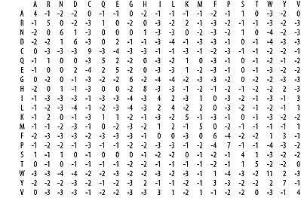
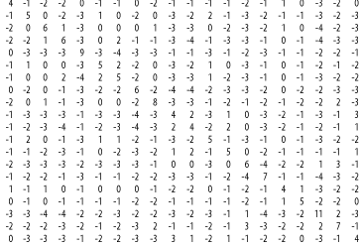
Batch-Write TAG
Performance Improvement over non-BW
Full adder: 25% less cycles
Logic operations: 25-37.5% less cycles
Why useful in Bioinformatics?
Amino acid scoring matrix (e.g., BLOSUM)
Full matrix is 23x23 → 529 truth table entries
1058 cycles to cover the entire matrix with old TAG
➔ 544 cycles with BW (48.5% less)

Slide 22
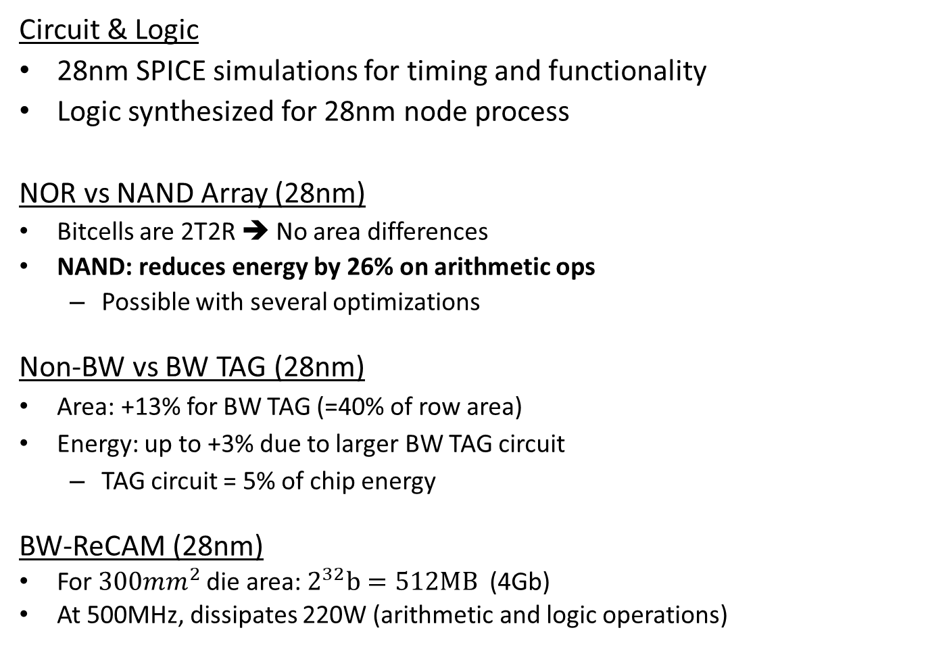
BW-ReCAM
Circuit & Logic
28nm SPICE simulations for timing and functionality
Logic synthesized for 28nm node process
NOR vs NAND Array (28nm)
Bitcells are 2T2R ➔ No area differences
NAND: reduces energy by 26% on arithmetic ops
  Possible with several optimizations
Non-BW vs BW TAG (28nm)
Area: +13% for BW TAG (=40% of row area)
Energy: up to +3% due to larger BW TAG circuit
  TAG circuit = 5% of chip energy
BW-ReCAM (28nm)
For $300mm^{2}$ die area: $2^{32}b=512MB$ (4Gb)
At 500MHz, dissipates 220W (arithmetic and logic operations)

Slide 23
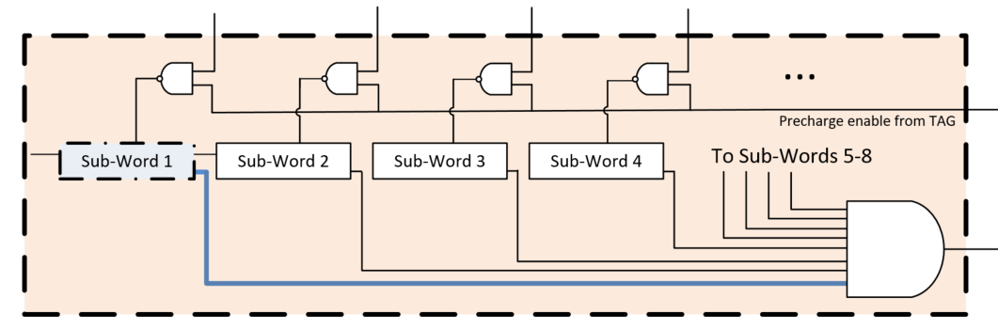
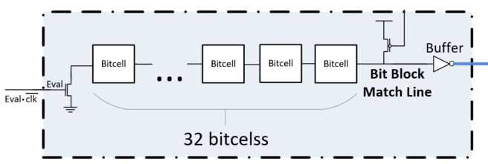
BioSEAL Array
All BW-ReCAM chips are daisy chained
  TAG of each chip connected to the chip below
  Virtually forming a long memory
Microcontroller: (1) issues instructions
(2) maps variables to bit columns
BW-ReCAM Array
BW-ReCAM Chip

Slide 24
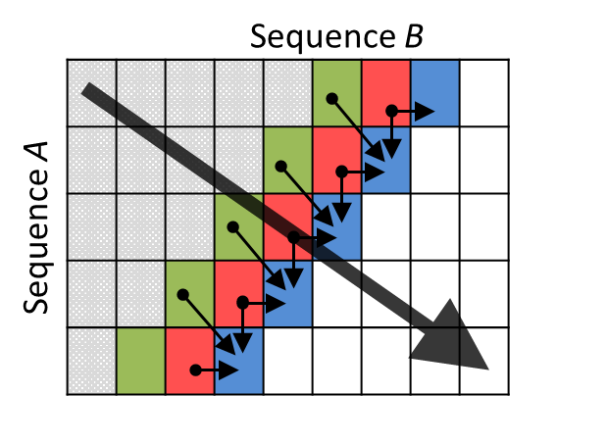
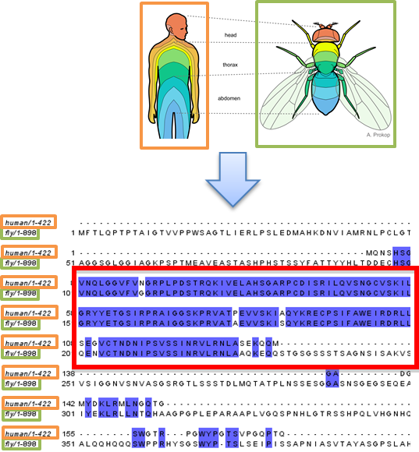
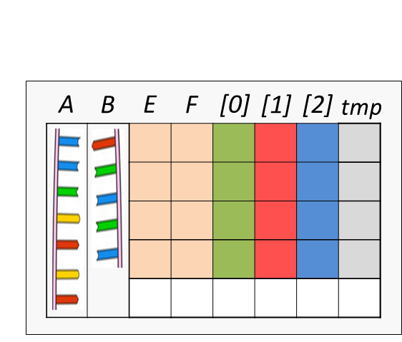

Local Sequence Alignment on BioSEAL
Finds similarity between two sequences (DNA/protein)
Also called Smith-Waterman algorithm (S-W)
Requires to calculate a dynamic programming matrix
  Time complexity: $O(n^{2})$
Previous work¹ showed S-W implementation in PRINS
a
Dynamic Programming Matrix
a
BW-ReCAM Memory
Map
[1] R. Kaplan, L. Yavits and R. Ginosar. "A Resistive CAM Processing-in-Storage Architecture for DNA Sequence Alignment."
IEEE Micro 37.4 (2017): 20-28.

Slide 25
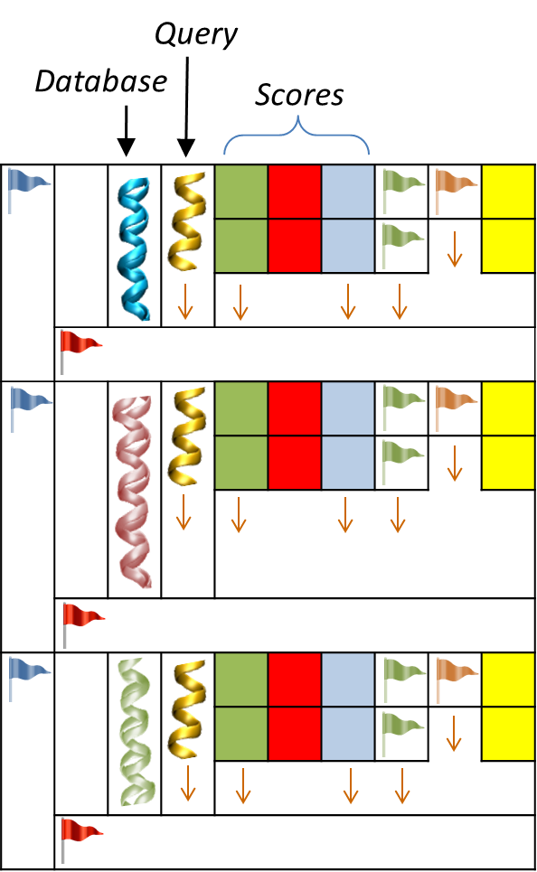
Multi Smith-Waterman on BioSEAL
New algorithm to align an entire database with a query
Exploits Flags (bits) and associative processing “tricks”
Each pairwise alignment has its max score
  Found by a max score reduction step
  Adds 17% per-iteration overhead, mitigated
  by the parallelism
BW-ReCAM Memory Map
Separate pairwise alignments
(performed in parallel)

Slide 26
Performance and Energy Efficiency Comparison
Compared with large-scale systems
Performance: measured in Cell Updates per Second (CUPS)
Energy efficiency: measured in CUPS per Watt
Other works vs BioSEAL
384 GPUs ⬄ 12 BW-ReCAM chips
[1]
[2]
[3]
[4]
[5]
[1]
[2]
[3]
[4]
[5]
[1] Liu, Y., et al.. SWAPHI-LS: Smith-Waterman Algorithm on Xeon Phi coprocessors for Long DNA Sequences. CLUSTER 2014. June (2014), 257–265.
[2] Wienbrandt, L. The FPGA-Based High-Performance Computer RIVYERA for Applications in Bioinformatics. (2014), 383–392.
[3] Sandes, E.F. de O. et al.. CUDAlign 4.0: Incremental Speculative Traceback for Exact Chromosome-Wide Alignment in GPU Clusters. IEEE TPDPS. 27, 10 (Oct. 2016).
[4] R. Kaplan et al. A Resistive CAM Processing-in-Storage Architecture for DNA Sequence Alignment. IEEE Micro 37.4 (2017): 20-28.
[5] Lan, H.et al. SWhybrid : A Hybrid-Parallel Framework for Large-Scale Protein Sequence Database Search. IPDPS 2017, pp. 42-51.

Slide 27
Thank you

