Slide 1
Scaling Shared Memory Multiprocessing Applications in Non-cache-coherent Domains
Ho-Ren (Jack) Chuang, Robert Lyerly, Stefan Lankes, Binoy Ravindran

Slide 2
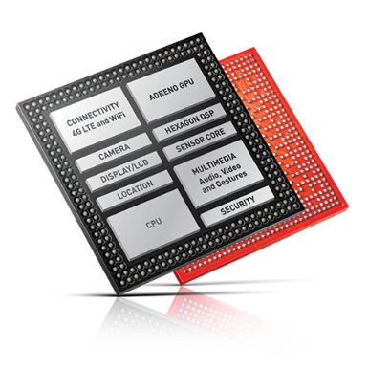
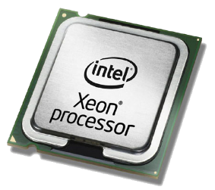
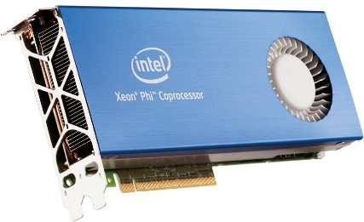
Trends in the cloud and datacenters
Specialized hardware
  Different ISAs
  Non-cache-coherent domains
Clusters of systems integrated via high-speed interconnects
  200 Gbps bandwidth with sub- microsecond end-to-end latencies

Slide 3
Background
Distributed Shared Memory (DSM)
  Intensively studied^{[1, 2, 4, 5, 19, 30, 31, 34]}
  Enable SMP programming model
Programmability
  High: run a SMP application as is on a non-cache-coherent setup
  Low: if you have to modify existing SMP application or even rewrite a new application

Slide 4
Problems
To support legacy applications, sequential memory consistency (SC) model is widely used
  Invalidation-based single-writer multi-reader protocol
Benefits of remote computing power vs DSM overheads
  Significant number of invalidation messages
  False page sharing
  Large number of read page faults
  Large synchronization overheads

Slide 5
Goal
How can developers target non-cache-coherent systems with both high programmability and high performance?
We improve performance by leveraging existing programming frameworks and relaxing memory consistency model while enabling high programmability.

Slide 6
Programmability
Parallel programming models
  Intel TBB^{[154]}, Intel Cilk^{[153]}, and OpenMP^{[54]}
A
A
Serial phase
B
Serial phase
B
Serial phase
C
C
Parallel phase
(work-sharing region)
Parallel phase
(work-sharing region)
Execution order

Slide 7
Multiple-writer (MW) protocol
Status of the page:
Exclusive
Shared
A
Copy of the page
Serial phase
B
Diff
C
Parallel phase
Node 0
W5
W2
XOR
=
(No INV messages)
(Confliction)
W4
W6
XOR
=
(Default-owner node)
Node 1
Time
(Default-owner
  node)
Work-sharing begin
MW merging phase begin
MW merging phase end
(Barrier begin)
(Barrier end / Work-sharing end)
Outside
work-sharing region
Outside
work-sharing region
MW Parallel Phase
MW Merging Phase

Slide 8
More designs in the paper
Smart regions
  Select the best consistency protocol for a given work-sharing region
Profiling data prefetch
  Aggressive data page prefetch
Cross-node synchronization
  Reduce redundant page faults caused by DSM

Slide 9
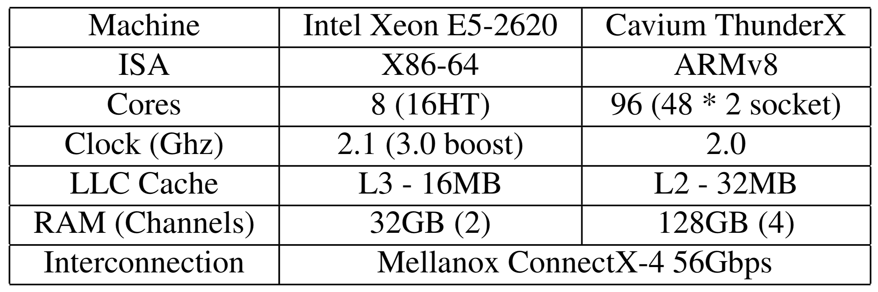
Evaluation environment
LOC modifications to the OpemMP4.5 runtime
Synchronization | 11(+), 3(-)
MW protocol | 33(+)
Hash function | 54(+)
Applicability
v4.4.137
x 96
Benchmark applications
Phoenix^{[43]} | Kmeans (KM)
PARSEC^{[35]} | Blackscholes (BLK)
NPB^{[42]} | Embarrassingly Parallel (EP), Conjugate Gradient (CG), Block Tri-diagonal solver (BT), Scalar Penta-diagonal solver (SP)
Rodinia^{[13]} | Hotspot2D (HS), Lava Molecular Dynamics (LAVA), Lower-Upper Decomposition (LUD)
x 16

Slide 10
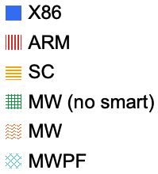
Experimental results
Up to 33%
(a) EP-C
(b) CG-D
(c) SP-C
Baseline
(d) BT-C
(e) BLK
(f) HS
On average 11% speedup
(g) KM
(h) LUD
(i) LAVA

Slide 11
Conclusions
MWPF achieves on average an 11% speedup versus the baseline DSM implementation without modification to application code
Performance in non-cache-coherent domains can be improved while enabling legacy SMP applications
Infrastructure available as open-source as part of the Popcorn Linux project: https://github.com/ssrg-vt/popcorn-kernel/tree/tso-adv

